Slide 1
SLR - semantic keywords for systematic literature reviews
Michał Gozdera, Małgorzata Hadasz, Krystian Kurek

Slide 2
Project content
1. Keywords extraction from medical papers abstracts
2. Tagging extracted keywords with ontologies concepts
3. Tags disambiguation

Slide 3
Concept, work plan, research methodology
Embedding tagger, NCBO tagger
BERTopic,
LDA
Articles (titles and abstracts)
Keywords
Concepts from ontologies
MedMentions ST21pv dataset
UMLS ontologies

Slide 4
Methods, techniques, devices to be used in research

Slide 5
LDA
Aim:
extract topic for each document
extract keywords for each topic
Data need to be preprocessed
Stop words removal
Stemming and lemmatization
Number of topic known beforehand
59 to match the BERTopic

Slide 6
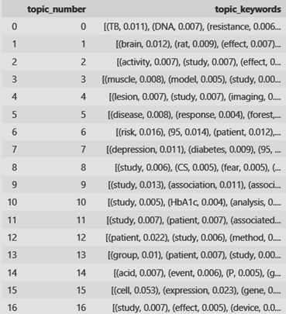
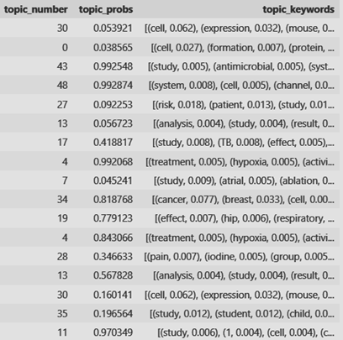
LDA results
Topics and their keywords
For document: topic number and its probability

Slide 7
BERTopic
Aim: extract 10 keywords from each abstract
Different data preprocessing attempts:
Raw data
Stopwords removal
Stemming and stopwords removal
Lemmatization and stopwords removal
Result: 59 different topics extracted from train set, each one having 10 keywords
Limitation: Significant number of papers classified as clustering outlier (1200-1400/3513)

Slide 8
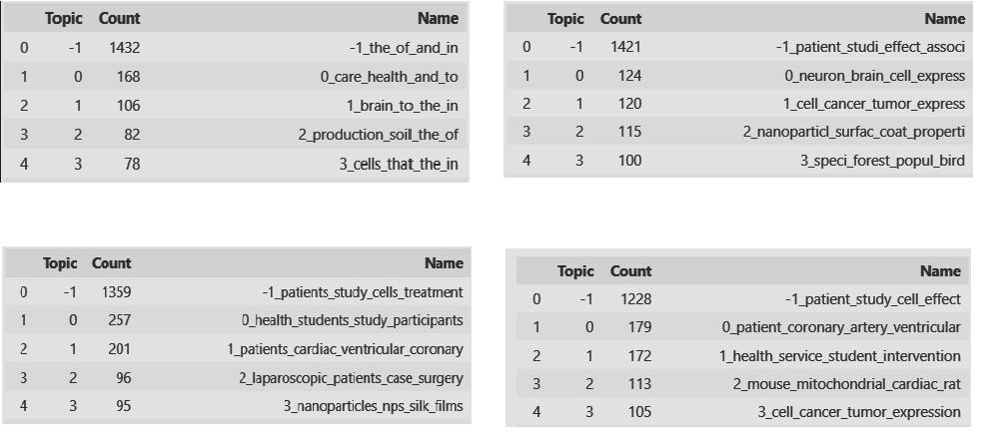
BERTopic results
Raw data
Stopwords removal + stemming
Stopwords removal
Stopwords removal + lemmatization

Slide 9
NCBO tagger
RESTapi communication (slow)
For each keword we match concept from ontology + take its ancestors in hierarchy
Taking into account 18 ontologies included in MedMentions ST21pv dataset
Testing two approaches reagrding semantic types: including all smeantic types and including only 21 ST21pv semantic types

Slide 10
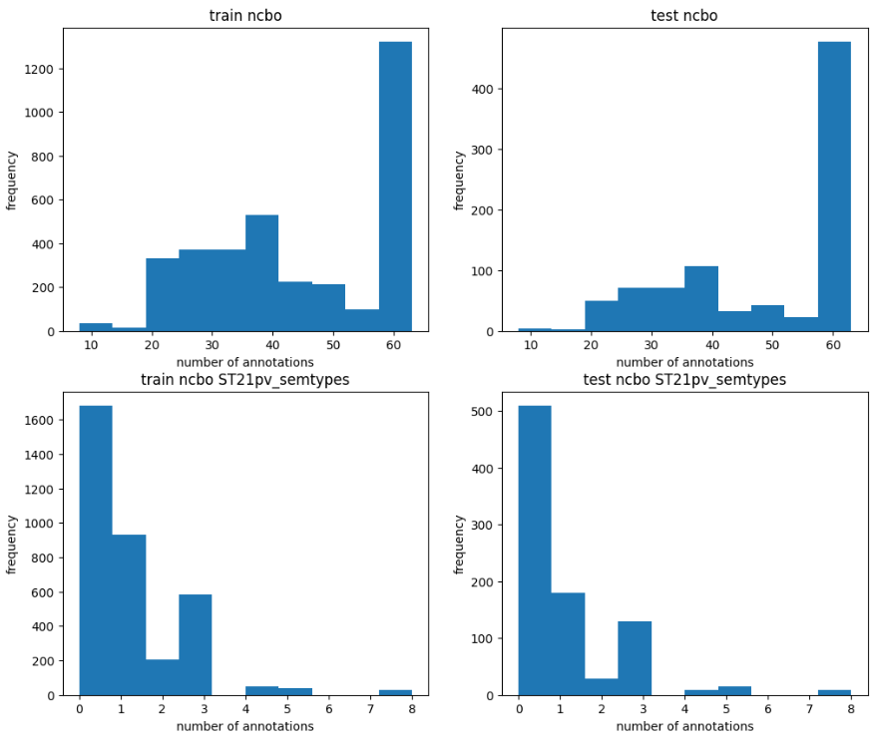
NCBO tagger – found keywords tags

Slide 11
Word2Vec
No support for out-of-vocabulary words
Solution: BERT
Words in vocabulary | Words out of vocabulary
8769 | 18534

Slide 12
Words embeddings tagger –bioBERT
Match keyword with concept with highest cosine similarity value
Examples:
Trivial |  | Usefull |  | Probably useless
keyword | tag | keyword | tag | keyword | tag
depression | Depression | imaging | analysis | mitochondrial | Palestinian
implant | Implant | neuron | Neurites | compared | Detective

Slide 13
Disambiguation
Aim: retrieve the most important concept for a keyword
Used method: Keywords-based Closest Sense
Modification of Sentence-based Closest Sense method
Self-implemented
Each step we look for the most similar concept

Slide 14
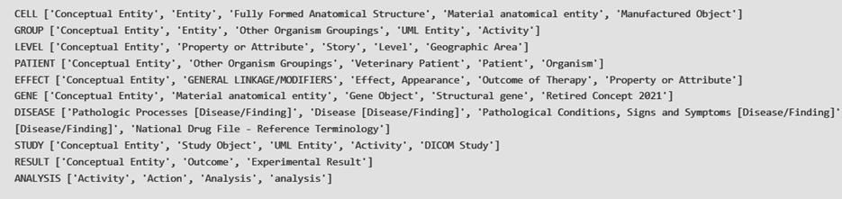
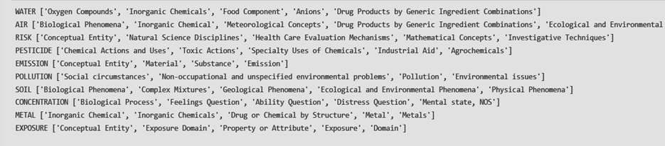
Disambiguation results - analysis

Slide 15
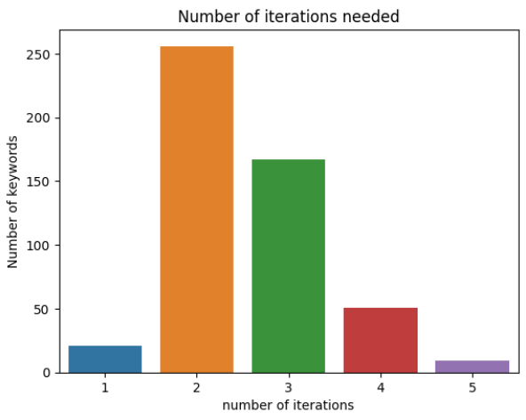
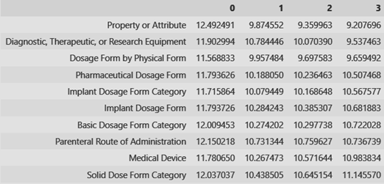
Disambiguation results - analysis
Changes for keyword IMPLANT

Slide 16
Difficulties
Many concept names for one concept – problem of choosing the best one
Inconsistency between MedMetions and UMLS
When we filtered concepts from UMLS we've got concept names only for ~25% concepts used as a ground truth in MedMentions
Problem of evaluating separate steps – we counted metrics only for complete solution

Slide 17
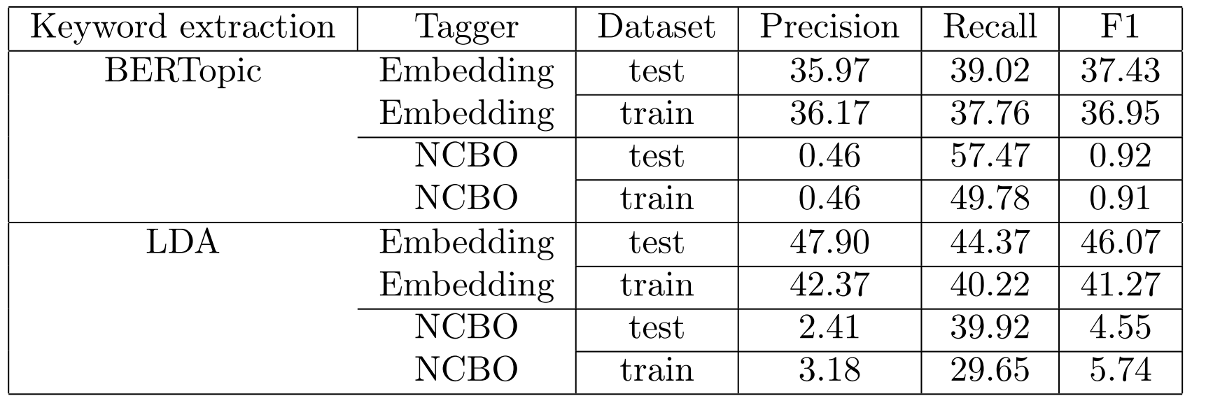
Results

Slide 18
Project 2 plan
Project 1 extensions and further experimetns:
Disambiguation improvement (initial sorting)
Higher number of topics, more keywords for a given topic
Considering keywords not only from the best topic
Adding paper searching based on user query and extracted keywords

Slide 19
It's the journey that counts,
not the destination

